Slide 1
Refs: S. Voida, D. Patterson, S. Patel (content), K. Li, K. Lee, R Wang (slide design)

Slide 2


Slide 3
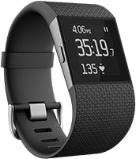
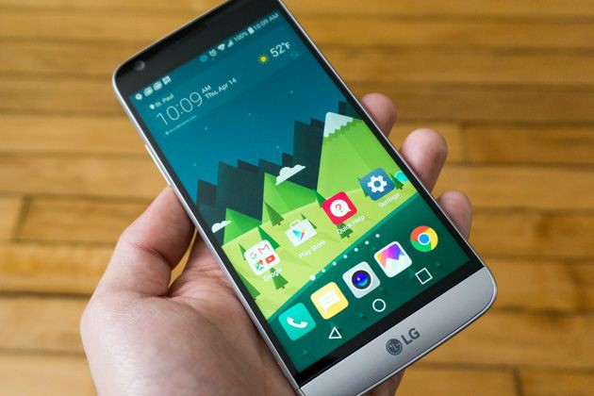
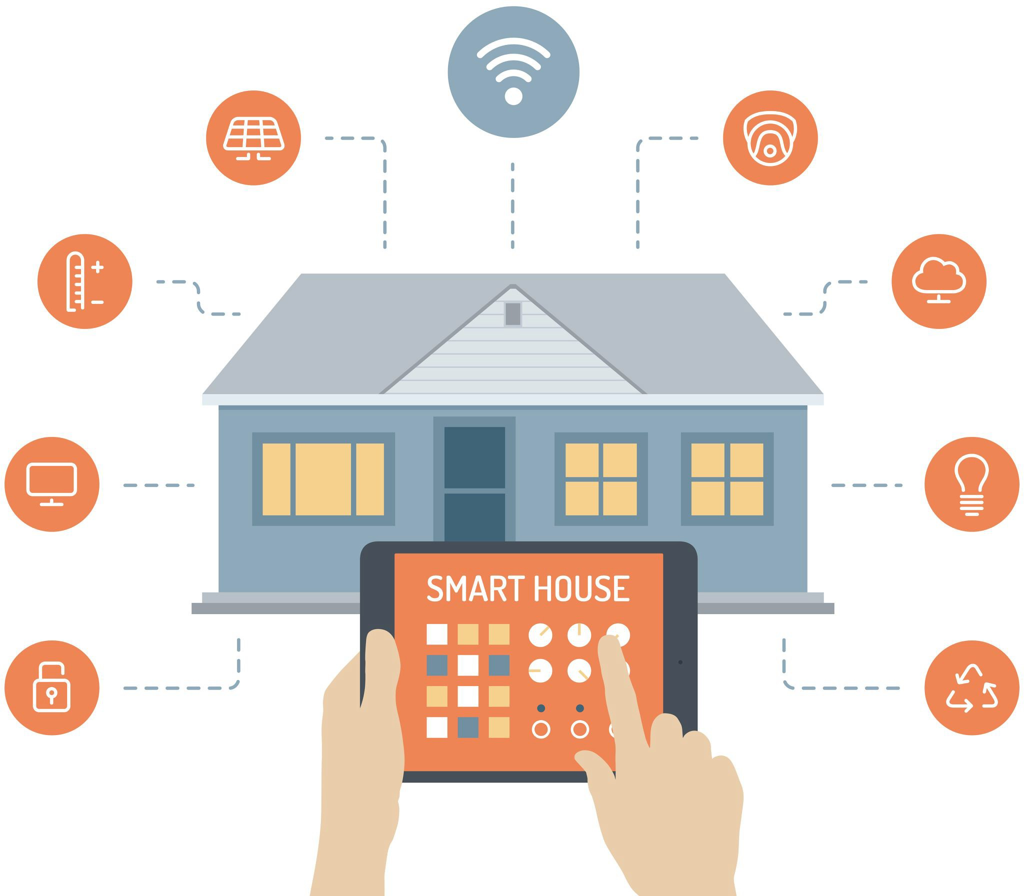

Slide 4


Slide 13


Slide 14


Slide 15
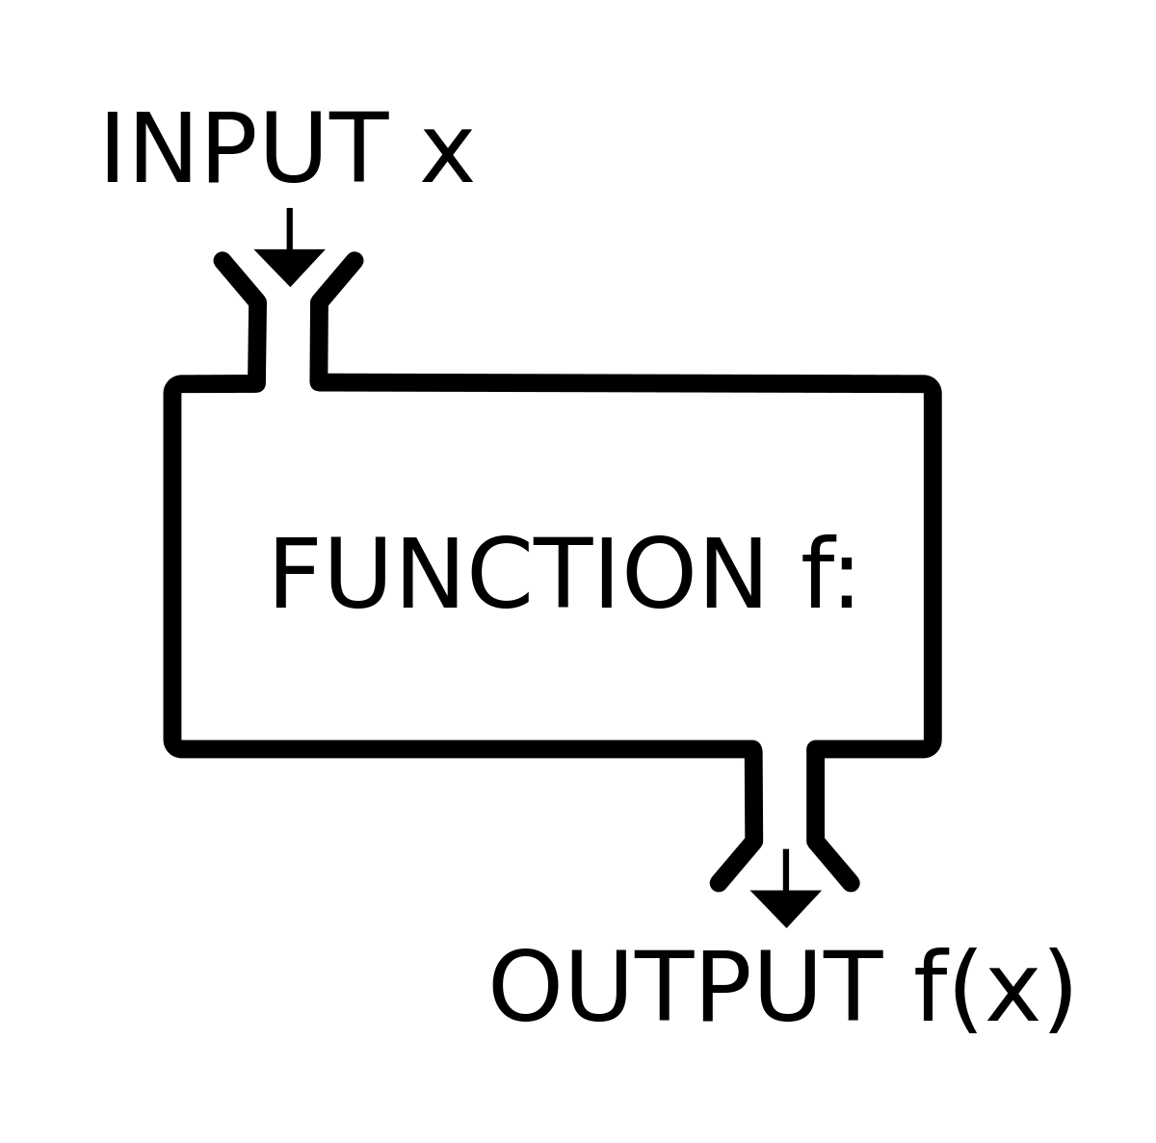
1
Forming
Research Goals/Questions
Sensor Data Stream
2
Building Sensors and Acquiring Data with Sensors
Model
4
Event Detection
3
Analyzing Data and Building a Model
Output
5
Making Sense of Data Stream

Slide 16
●
Real-Time Data Stream
●
Event Detection
●
●
Output
Making Sense of Data Stream

